Slide 1
Univariate Time Series module 3
Note to other teachers and users of these slides. Feel free to use or modify these slides as you wish. If you use a significant portion of these slides in your own lecture, please include this message, or the following link to the source repository of Michele’s lectures on github:
https://github.com/samorani. Comments and corrections are welcome.

Slide 2
This course
Visualization packages
Matplotlib /
Seaborn
scikitlearn
Machine learning package
TODAY
pandas
Data structures package
numpy
Computation package
Python
Language, syntax

Slide 3
Univariate Time Series
Definition from here: a sequence of measurements of the same variable collected over time. Examples: stock prices, demand, housing prices.
In pandas a univariate time series is a Series object where the index is a "timestamp".

Slide 4
Today’s data
Today we will look at two time series:
The price of Alphabet shares (GOOGL)
The median housing price in Santa Clara
Our goals are:
Practice data manipulation with Series
Assess correlation between stock market and housing prices in the Bay Area

Slide 5
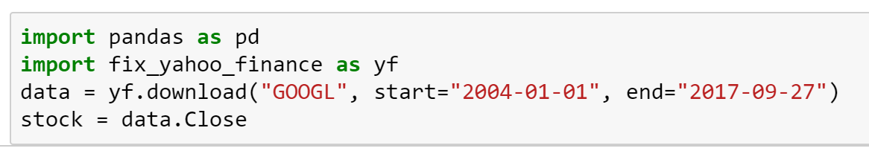
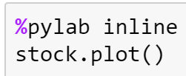
Create the Series object stock
Stock symbol to track
Dates
Plot the price using matplotlib

Slide 6
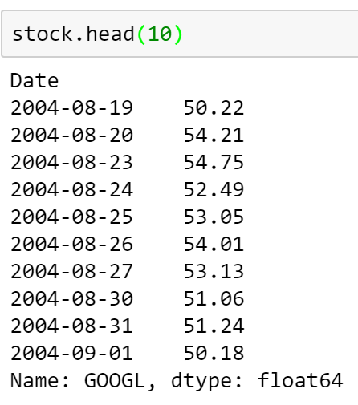
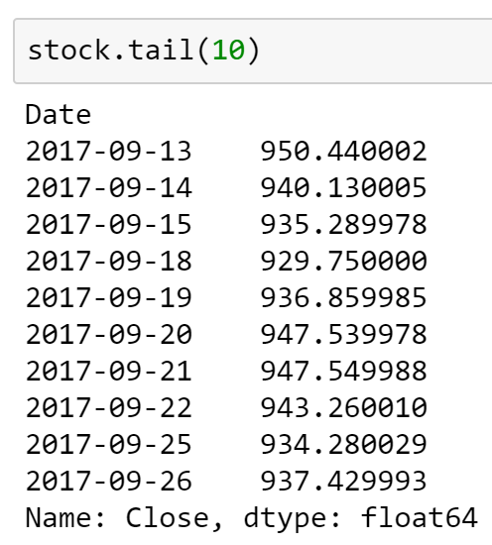
Take a look at stock
This Series object has one entry for each trading day. The index (of type datetime64) is the day and the value (of type float64) is the closing price.

Slide 7
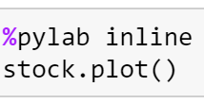
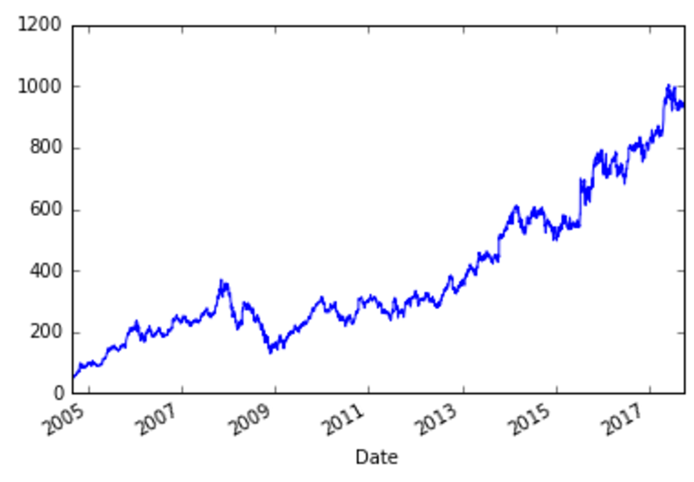
GOOGL price

Slide 8
Some problems
What day had the largest stock price?
In class
What are the 10 days with largest stock price? Report both the day and the price.
In class
How much profit (%) would we make if we bought at the beginning and sold everything on the last day? Do not type in any date.
In class
What is the moving average of the price at each trading session? Use a 50-trading-days window. Hint: Explore the method rolling
In class
Consider this investment strategy: buy on day x and then sell after 5 days (on day x+5). Find the expected profit (in %) of this operation. Hint: explore the method shift
In class
Consider this investment strategy: buy whenever the price goes above the 20-day moving average, and then sell after 5 trading sessions. How much profit (in %) would we make on average?
In class

Slide 9
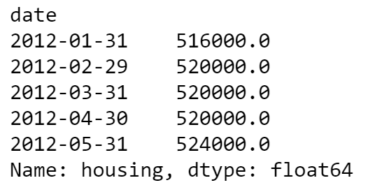
Housing Prices
The file santaclara_sfh.csv was downloaded from redfin.com.
For each end of month day, this file reports the median price of a single family home (sfh) in zip code 95050 over the previous 3 months.
Median price of sales between
2012-02-01 and 2012-04-30

Slide 10
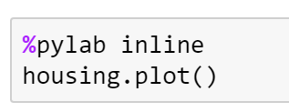
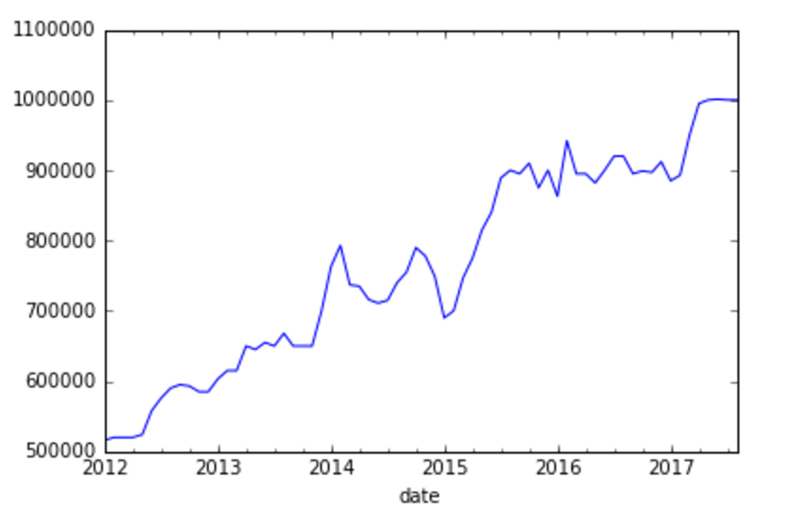
Housing Prices

Slide 11
Are housing prices correlated to Alphabet stock prices?
To anwer this question, we first need to align the two Series. The Series housing has one try for each ending day of each month and a value that is the 3-month moving median; the series stock has one entry for each trading day and the value that is the closing price.
We will do the following:
“Pad” stock so that there are no missing days (currently, holidays are missing)
Compute the 3-month moving median of stock
Retain only the end-of-month days in stock

Slide 12
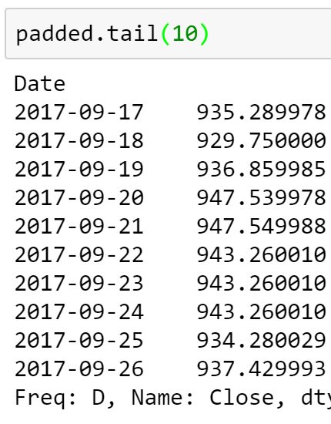


1. Add missing days with asfreq
The method asfreq changes the frequency of the series (in this case to 1 day) and fill the holes by propagating forward (ffill) or backward (bfill)

Slide 13
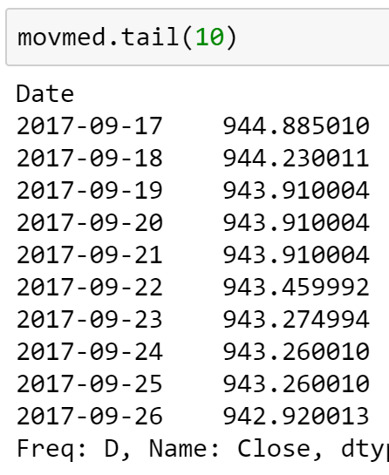
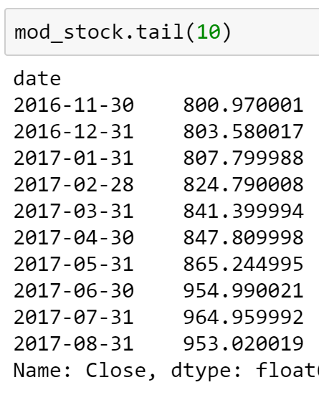

3. Retain the same days as in the housing Series

Slide 14
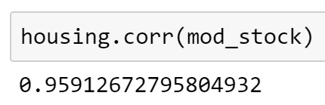
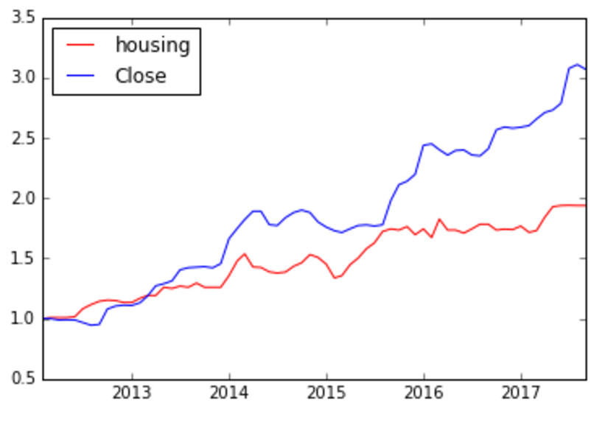
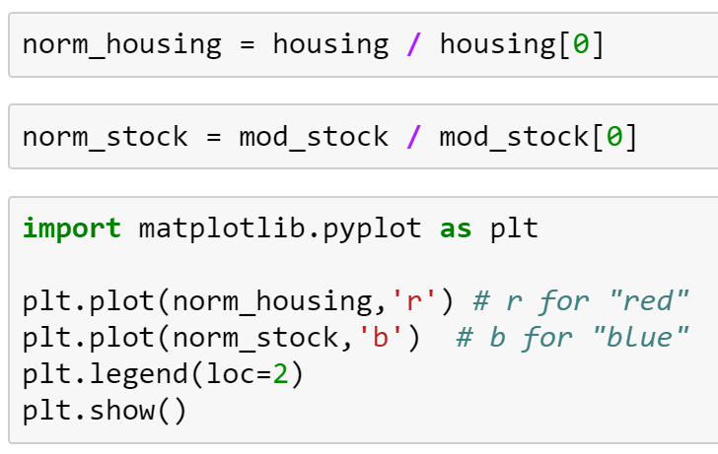
Correlation Housing Prices vs GOOGL
REALLY HIGH!
Normalized at Feb 2012

